Slide 1
Nuclear Magnetic Resonance (NMR) spectroscopy

Slide 2
WHAT IS NMR AND WHAT DOES AN NMR SPECTRUM TELL YOU?
Proton nuclear magnetic resonance spectroscopy provides...
information about the hydrogen atoms in molecules
It provides the information by...
spinning a sample of the compound in a magnetic field
hydrogen atoms in different environments respond differently to the field
each different environment of hydrogen produces a signal in a different
position
the area under each peak / signal is proportional to the number of hydrogens
signal can be split according to how many H’s are on adjacent atoms

Slide 3
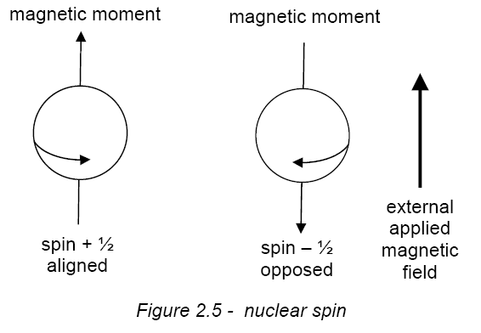
Magnetic properties of the nucleus

Slide 4
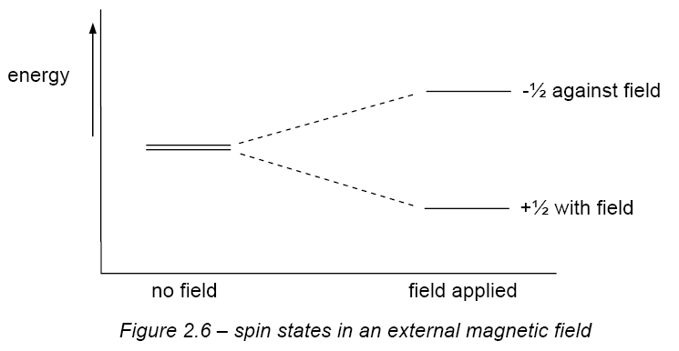
NMR SPECTROSCOPY – ORIGIN OF SPECTRA
A spinning nucleus such as ¹H behaves as a spinning charge and generates a magnetic field. It can be likened to a bar magnet. When it is placed in an externally applied field it can align with, or against, the field. The energy difference between the two states (ΔΕ) depends on the applied field.
ΔΕ = hν

Slide 5
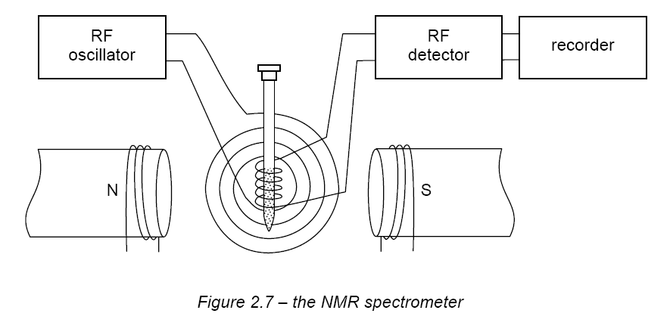
NMR SPECTROMETERS
The sample is spun round in the field of a large electromagnet and a radio-frequency (RF) field is applied. The magnetic field is increased and the excitation or “flipping” of nuclei from one orientation to another is detected as an induced voltage resulting from the absorption of energy from the RF field.
An nmr spectrum is the plot of the induced voltage against the sweep of the field. The area under a peak is proportional to the number of nuclei “flipping”
Not all hydrogen nuclei absorb energy at the same field strength at a given frequency; the field strength required depends on the environment of the hydrogen.
By observing the field strength at which protons absorb energy, one can deduce something about the structure of a molecule.
THE BASIC ELEMENTS OF AN NMR SPECTROMETER

Slide 6
NMR SPECTROSCOPY
OBTAINING SPECTRA
a liquid sample is placed in a tube which spins in a magnetic field
solids are dissolved in solvents which won’t affect the spectrum - CCl₄, CDCl₃
TMS, tetramethylsilane, (CH₃)₄Si, is added to provide a reference signal
when the spectrum has been run, it can be integrated to find the relative peak areas
spectrometers are now linked to computers to analyse data and store information
INTERPRETATION OF SPECTRA
NMR spectra provide information about the structure of organic molecules from the ...
number of different signals in the spectrum
position of the signals (chemical shift)
intensity of the signals
splitting pattern of the signals

Slide 7
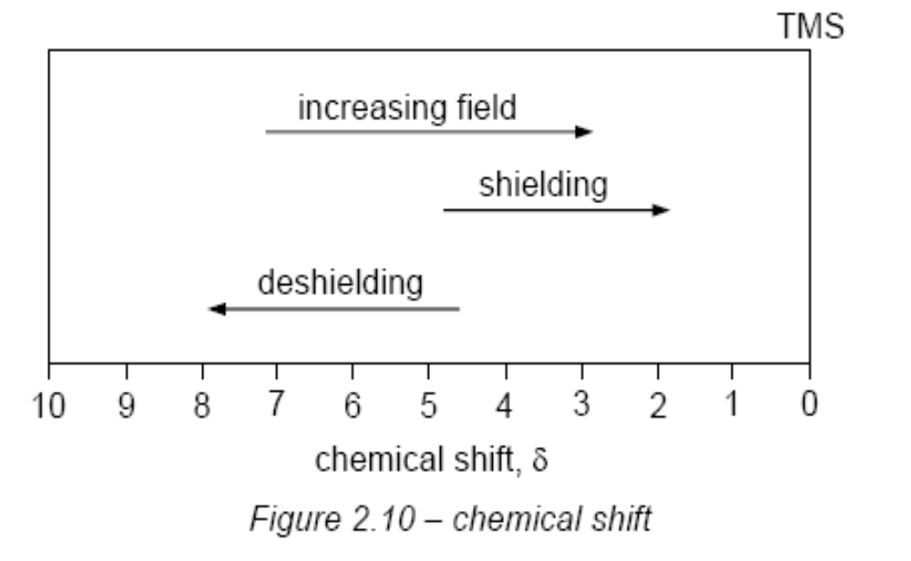
An NMR spectrum consists of a graph of absorbance against frequency.
The frequency scale is measured in units of chemical shift (symbol δ).
The chemical shift of a proton is the difference between its absorption frequency and that of TMS, measured in part per million (ppm).
Most protons in organic molecules resonate within 10 ppm of TMS, and by convention, the zero point of the scale (TMS) is on the right hand side

Slide 8
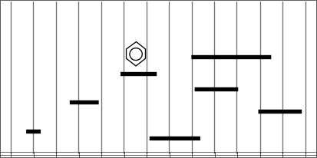
CHEMICAL SHIFT
each proton type is said to be chemically shifted relative to a standard
(usually TMS)
the chemical shift is the difference between the field strength at which it
absorbs and the field strength at which TMS protons absorb
the delta (δ) scale is widely used as a means of reporting chemical shifts
the TMS peak is assigned a value of ZERO (δ = 0.00)
H’s near to an electronegative species are shifted “downfield” to higher δ
values
H
Approximate
chemical shifts
The actual values depend on the environment
- C - X
ROH
-CHO
- C - H
-COOH
-C=CH-
TMS
13 12 11 10 9 8 7 6 5 4 3 2 1 0 δ
DOWNFIELD - ‘deshielding’

Slide 9
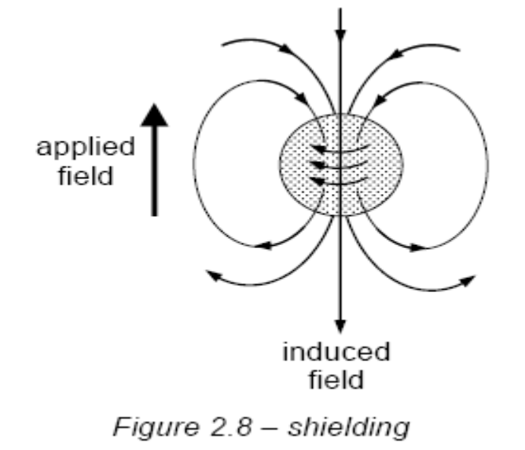
Chemical shifts in NMR lies in the degree to which a magnetic nucleus is shielded from the applied magnetic field by electron surrounding the nucleus.
Shielding
Protons are surrounded (shielded) only by σ-electrons which are spherically symmetric in distribution around the nucleus.
When a molecule is placed in an external field, the σ-electrons produce a magnetic field which opposes the external field. This phenomenon is called diamagnetism.
∴Shielding caused: - lower chemical shift
- lower δ

Slide 10
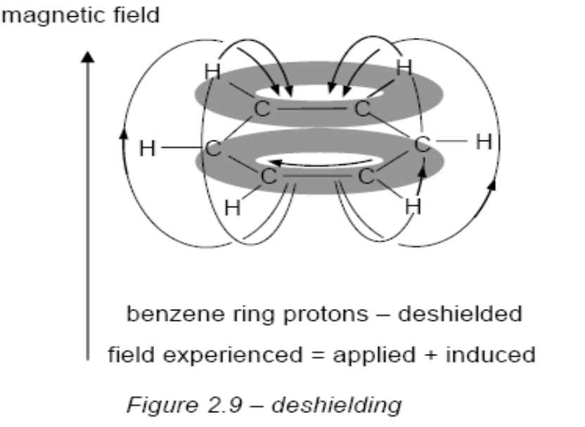
Deshielding
Any influence which reduces the electrons density will reduce the shielding effect and the nucleus is said to be deshielded
Lead to higher δ
π-electrons also generate magnetic fields, but unlike the σ-electrons which always shield spinning nuclei, π-electrons may deshield spinning nuclei or shield spinning nuclei depending upon whether the lines of force (magnetic moment) generated by the π-electrons is parallel (deshield) or anti-parallel (shield).
Aromatic ring

Slide 11
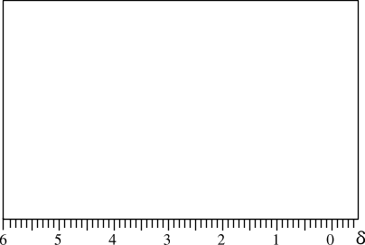
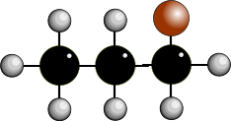
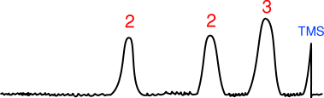
LOW RESOLUTION - HIGH RESOLUTION
low resolution nmr gives 1 peak for each environmentally different group of protons
high resolution gives more complex signals - doublets, triplets, quartets, quintets,
sextets, multiplets
the signal produced indicates the number of protons on adjacent carbon atoms
LOW RESOLUTION SPECTRUM OF 1-BROMOPROPANE

Slide 12
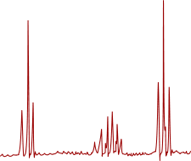

LOW RESOLUTION - HIGH RESOLUTION
low resolution nmr gives 1 peak for each environmentally different group of protons
high resolution gives more complex signals - doublets, triplets, quartets, multiplets
the signal produced indicates the number of protons on adjacent carbon atoms
HIGH RESOLUTION SPECTRUM OF 1-BROMOPROPANE
The broad peaks are split into sharper signals
The splitting pattern depends on the number of hydrogen atoms on adjacent atoms

Slide 13
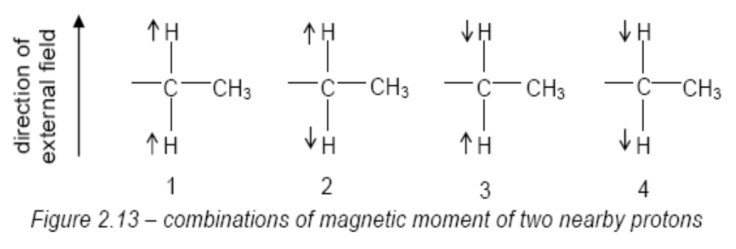
2 adjacent H’s
more possible combinations
get 3 peaks in the ratio 1 : 2 : 1

Slide 14
MULTIPLICITY (Spin-spin splitting)
low resolution nmr gives 1 peak for each environmentally different group of protons
high resolution gives more complex signals - doublets, triplets, quartets, multiplets
the signal produced indicates the number of protons on adjacent carbon atoms
Number of peaks = number of chemically different H’s on adjacent atoms + 1
1 neighbouring H 2 peaks “doublet” 1:1
2 neighbouring H’s 3 peaks “triplet” 1:2:1
3 neighbouring H’s 4 peaks “quartet” 1:3:3:1
4 neighbouring H’s 5 peaks “quintet” 1:4:6:4:1
Signals for the H in an O-H bond are unaffected by hydrogens on adjacent atoms - get a singlet

Slide 15
MULTIPLICITY (Spin-spin splitting)
low resolution nmr gives 1 peak for each environmentally different group of protons
high resolution gives more complex signals - doublets, triplets, quartets, multiplets
the signal produced indicates the number of protons on adjacent carbon atoms
Number of peaks = number of chemically different H’s on adjacent atoms + 1
0 neighbouring H’s signal isn’t split 1 peak “singlet”
1 neighbouring H signal split into 2 peaks “doublet” ratio = 1:1
2 neighbouring H’s 3 peaks “triplet” 1:2:1
3 neighbouring H’s 4 peaks “quartet” 1:3:3:1
4 neighbouring H’s 5 peaks “quintet” 1:4:6:4:1

Slide 16
MULTIPLICITY (Spin-spin splitting)
low resolution nmr gives 1 peak for each environmentally different group of protons
high resolution gives more complex signals - doublets, triplets, quartets, multiplets
the signal produced indicates the number of protons on adjacent carbon atoms
Number of peaks = number of chemically different H’s on adjacent atoms + 1
0 neighbouring H’s signal isn’t split 1 peak “singlet”
1 neighbouring H signal split into 2 peaks “doublet” ratio = 1:1
2 neighbouring H’s 3 peaks “triplet” 1:2:1
3 neighbouring H’s 4 peaks “quartet” 1:3:3:1
4 neighbouring H’s 5 peaks “quintet” 1:4:6:4:1
PASCAL’S TRIANGLE
1
1 1
1 2 1
1 3 3 1
1 4 6 4 1
1 5 10 10 5 1
It is interesting to note the relationship between the successive peak ratios. It follows the pattern found in Pascal’s triangle.
Each number in the series is the sum of the two numbers above it in the triangle
What would be the pattern for 6 neighbouring hydrogens?
1 6 15 20 15 6 1
PRESS THE SPACE BAR FOR THE ANSWER

Slide 17
MULTIPLICITY (Spin-spin splitting)
4 adjacent H’s
gives 5 peaks in the ratio 1 : 4 : 6 : 4 : 1

Slide 18
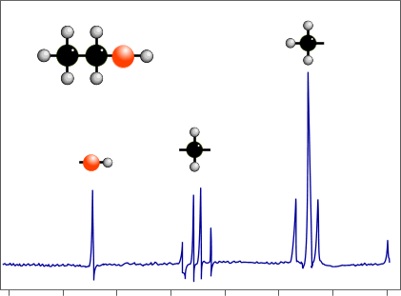
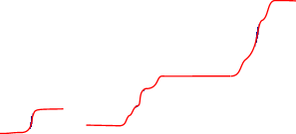
INTEGRATION
the area under a signal is proportional to the number of hydrogen atoms present
an integration device scans the area under the peaks
lines on the spectrum show the relative abundance of each hydrogen type
By measuring the distances between the integration lines one can
work out the simple ratio between the various types of hydrogen.
before integration after integration
NOTICE THAT THE O-H SIGNAL IS ONLY A SINGLET

Slide 19
INTEGRATION
Measure the distance between the top and bottom lines.
Compare the heights from each signal and make them into a simple ratio.
HOW TO WORK OUT THE SIMPLE RATIOS
Measure how much each integration line rises as it goes of a set of signals
Compare the relative values and work out the simple ratio between them
In the above spectrum the rises are in the ratio... 1:2:3
IMPORTANT: It doesn’t provide the actual number of H’s in each environment, just the ratio

Slide 20
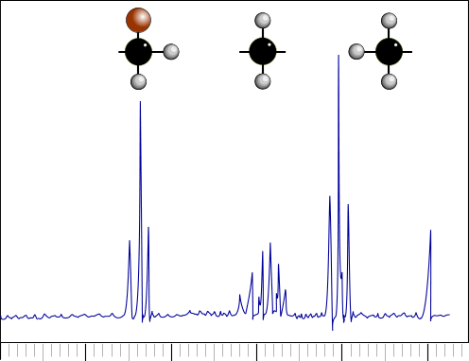

Spectrum of 1-bromopropane
SPLITTING
3 environments = 3 signals
1 Triplet δ = 1.0 3 H’s
2 Sextet δ = 1.9 2 H’s
3 Triplet δ = 3.4 2 H’s
Signal for H’s on carbon 3 is shifted furthest downfield from TMS due to proximity of the electronegative halogen
3
2
1
1
2
3
TMS
5 4 3 2 1 0 δ

Slide 21

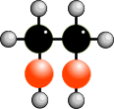
NMR SPECTROSCOPY
When is a hydrogen chemically different?
TWO SIGNALS
Quartet and triplet :- ratio of peak areas = 2 : 3
Carbons 1 & 4 are the similar and so are carbons 2 & 3 so there are only two different chemical environments.
The signal for H’s on carbon 2 is a quartet - you ignore the two neighbours on carbon 3 because they are chemically identical.
TWO SIGNALS
both singlets :- ratio of peak areas = 2 : 1
Hydrogens on OH groups only give singlets. The signal for H’s on each carbon are not split, because
- H’s on the neighbouring carbon are chemically
identical... and
- H’s on adjacent OH groups do not couple.
1
2
3
4
BUTANE
ETHANE-1,2-DIOL

Slide 22
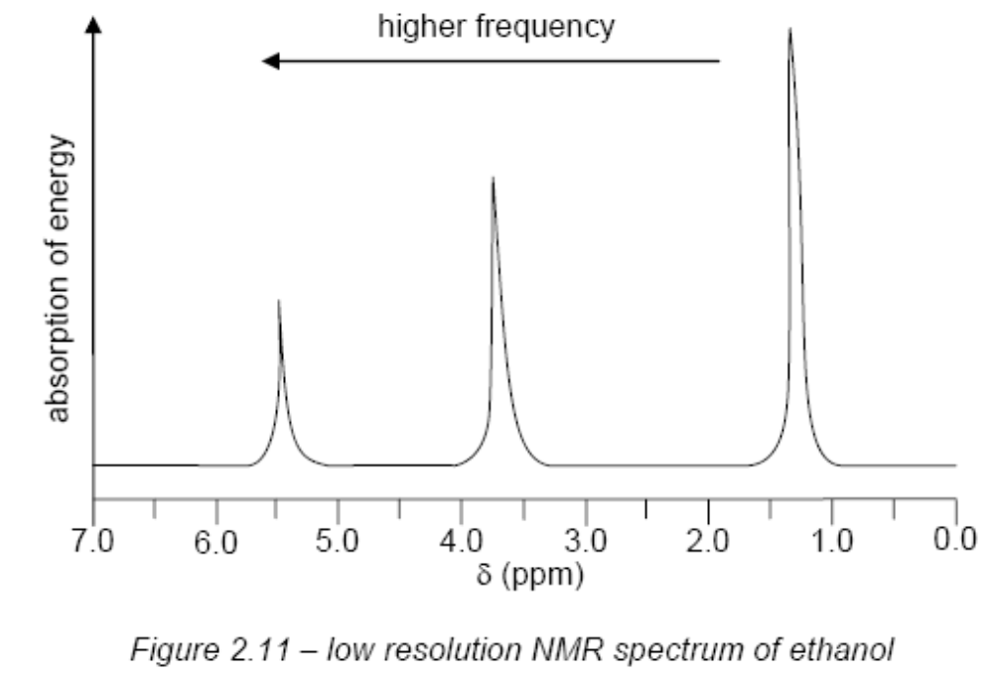
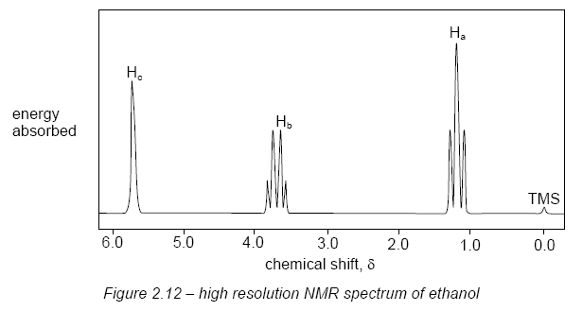

Slide 23
the –OH proton is a singlet
whereas you might have expected it to be split by the adjacent -CH₂- protons into a triplet & expected the -CH₂- protons to appear as a quintet – split by the three -CH₃ protons and also by the -OH proton.
This splitting does not occur because protons on –OH groups undergo rapid exchange with each other, and with protons on other –OH groups such as those in water. This means that adjacent protons only experience an averaged-out field of all the exchanging protons.
(The –OH absorption in ultra-dry ethanol does in fact appear as a triplet).
CH₃CH₂OH + H₂O ⇌ CH₃CH₂OH + HOH

Slide 24
A useful application of this ready exchange of –OH protons is the disappearance of their absorption peak when an NMR sample is shaken with D₂O (D is deuterium, ²H). The deuterium nucleus does not absorb in the same frequency range as 1H.
CH₃CH₂OH + D₂O ⇌ CH₃CH₂OD + HOD

Slide 25

